Slide 1



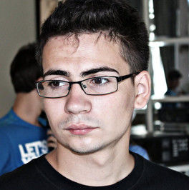
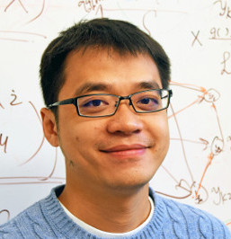
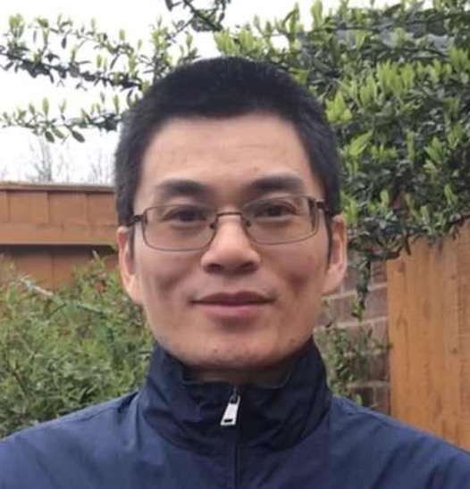

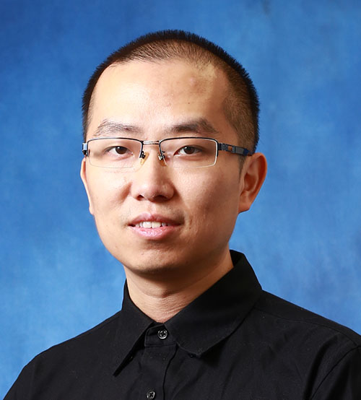


EdgeViTs: Competing Light-weight CNNs on Mobile Devices with Vision Transformers
Junting Pan Adrain Bulat Fuwen Tan Xiatian Zhu Lukasz Dudziak Hongsheng Li G.Tzimiropoulos Brais Martinez
Notes:
Hello everyone! My name is Junting Pan and I am going to present our work: EdgeViTs: Competing light–weight CNNs on mobile devices with vision transformers.

Slide 2
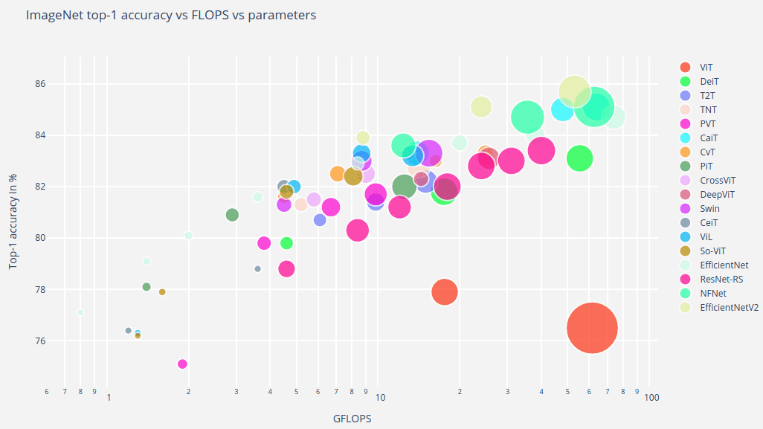

SOTA ViTs: The bigger the better.
Image Credit to: https://iaml-it.github.io/posts/2021-04-28-transformers-in-vision/
Notes:
Recently, vision transformers has demonstrated significant performance boosts over previous Convolutional Neural Networks. Given the quadratic complexity of self-attention operation in the Vision Transformers, and we can see the current trend is that we are having more accurate models but at the cost of more computational cost.

Slide 3
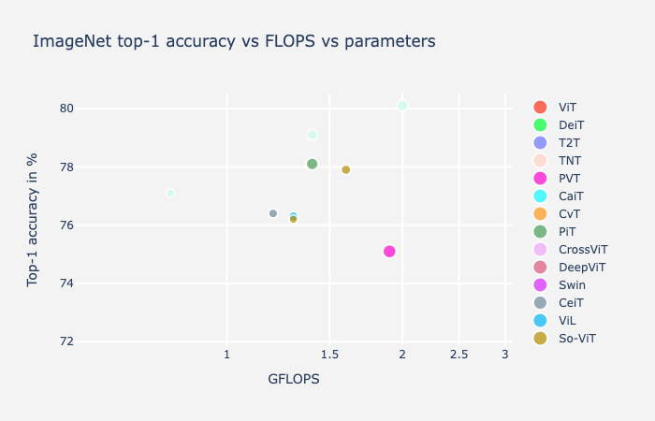

At mobile device regime: ViTs behind CNNs
EfficientNets
Image Credit to: https://iaml-it.github.io/posts/2021-04-28-transformers-in-vision/
Notes:
However, for real applications, computational budget is often limited. When constraining the budget under 2 GFlops, Vision Transformers underperform current efficient Convolutional Neural Networks.

Slide 4
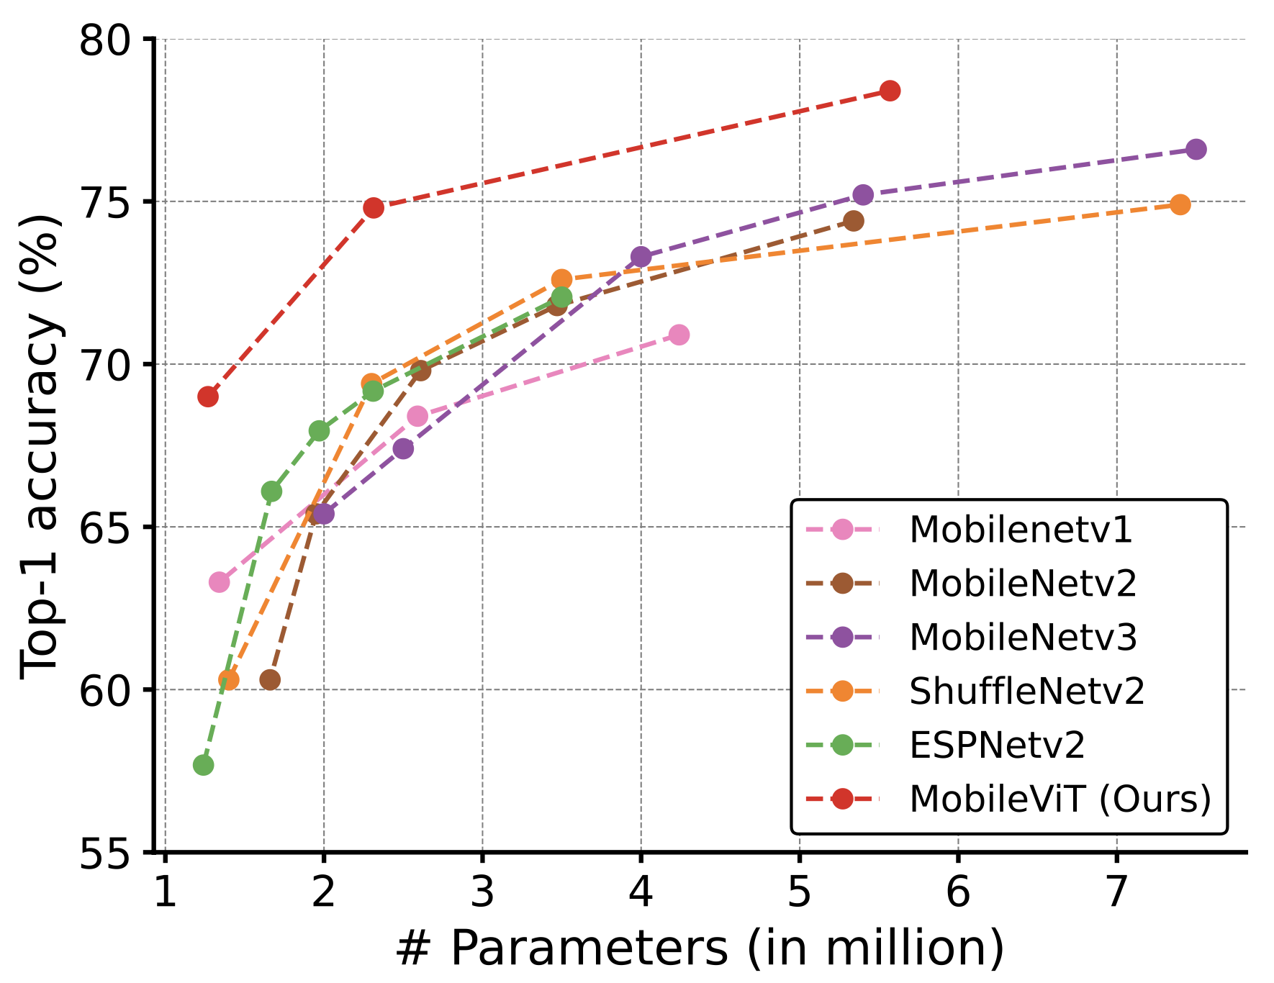
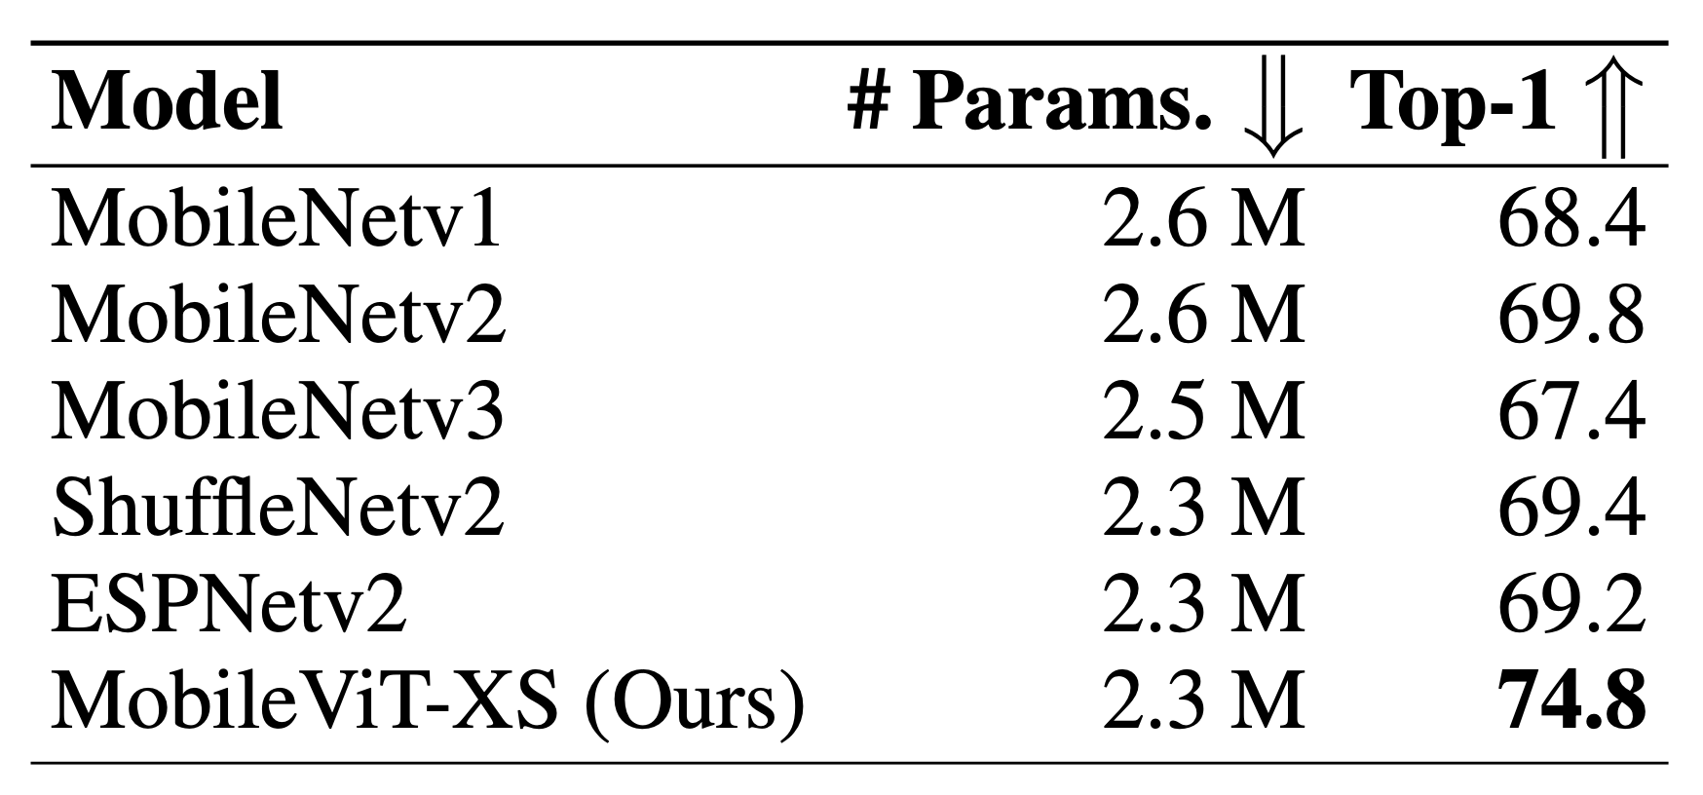
A recent attempt: MobileViT¹ (ICLR’22)
Other important aspects such as latency, energy consumption are not considered 🙁.
Mehta et. al. MobileViT: Light-weight, General-purpose, and Mobile-friendly Vision Transformer. ICLR, 2022.
Notes:
In the literature, very recent MobileViTs are the only series of ViTs designed for mobile devices. However, the only mobile budget criteria that they used was the model size. However, model size can not directly reflect the model efficiency. It is an approximation of, but usually not equivalent to what we really care about, such as latency. For example, EfficientNet-B0 runs much faster and accurate than MobileViT-XS despite being two times larger in model size.

Slide 5
What do we expect for an efficient ViTs?
Inference efficiency: The model should be fast, accurate and of low power consumption.
Model size: The model should be lightweight.
Implementational friendliness: Easier to implement with standard computing operations, without costly per-framework specialization.
Notes:
In this work we consider a collection of very practical design requirement, including: inference efficiency in terms of speed o latency and also energy consumption. We seek for an affordable model size for mobile devices, however this constraint has been relaxed significantly given the availability of ever cheaper and larger storage spaces. Additionally, implementation friendliness is also critical for model deployment, since standard operations are usually well optimized for different frameworks thus we don’t need costly per-framework specialization.

Slide 6

EdgeViTs!
Notes:
Following such design principles, we introduce EdgeViTs, for the first time enabling ViTs to compete with the best light-weight CNNS.

Slide 7
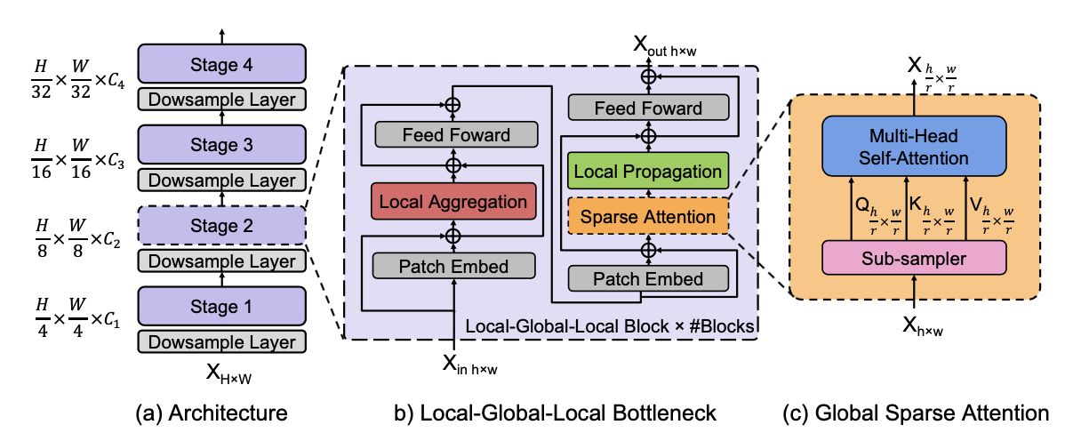
EdgeViTs: Overview
EdgeViT consists of 4 stages of Local-Global-Local (LGL) blocks in a pyramidal shape.
The LGL blocks is designed to replace standard self-attention with low complexity and easy-to-implement operations for better efficiency.
Fig.1 Schematic Overview
Notes:
For EdgeViTs We adopt a hierarchical pyramid network structure of 4 stages. The key design in our model is that we replace the standard self-attention operations with proposed Local-Global-Local blocks that can reduces the compute overhead and largely accelerate the model inference speed while maintaining the model accuracy.

Slide 8
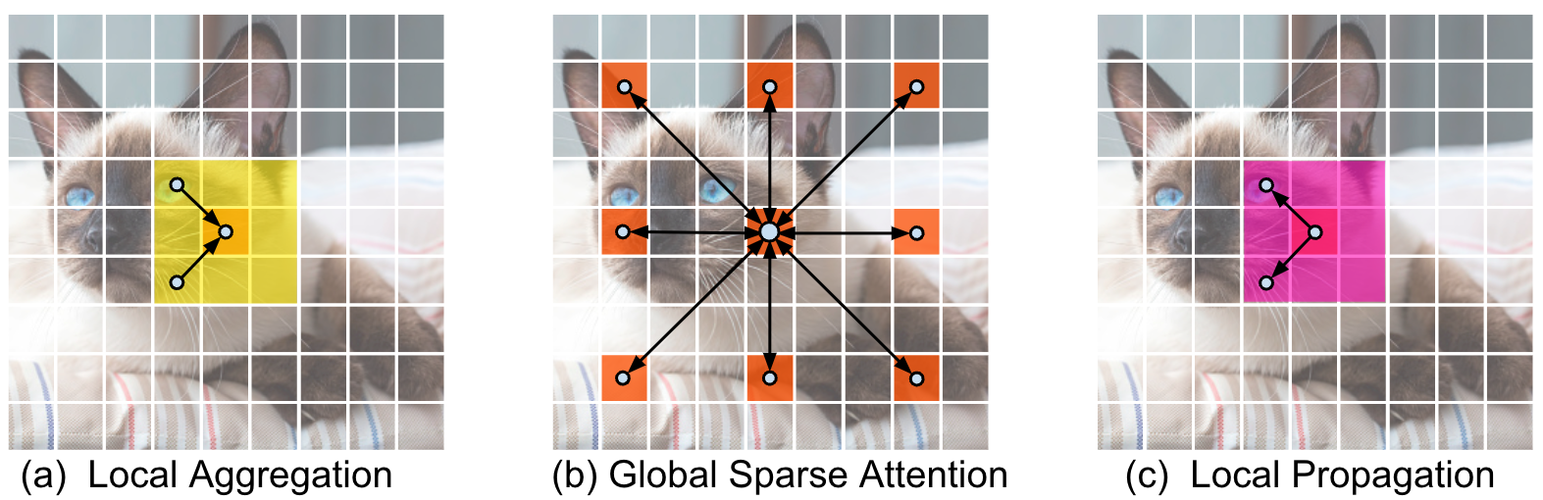
EdgeViTs: LGL Block
Three key operations are:
Local information aggregation from neighbor tokens.
Long-range information exchange by self-attention between delegate tokens.
Diffusing information from delegates to local neighborhood.
Fig.2 Illustration of three key operations involved in the proposed Local-GlobalLocal (LGL) transformer block.
Notes:
In details, the three efficient operations are involved in the LGL blocks:
(1) First, we aggregate information from local neighbor tokens with depth-wise convolutions
(2) Then, we perform long-range information exchange between a sparse of tokens distributed across the space with self-attention.
(3) Finally, updated information is diffused from delegates to the non-delegate tokens in local neighborhoods via transposed convolutions.

Slide 9
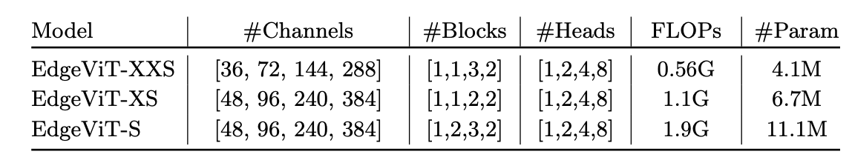
EdgeViTs: Different compute budgets
To support a variety of computational budgets, we present a family of EdgeViTs:
Table 1. Configuration of three EdgeViT variants.
Notes:
We build a family of EdgeViTs with the proposed LGL bottleneck at different computational complexities ranging from 0.5GFlops to 2 GFlops.

Slide 10
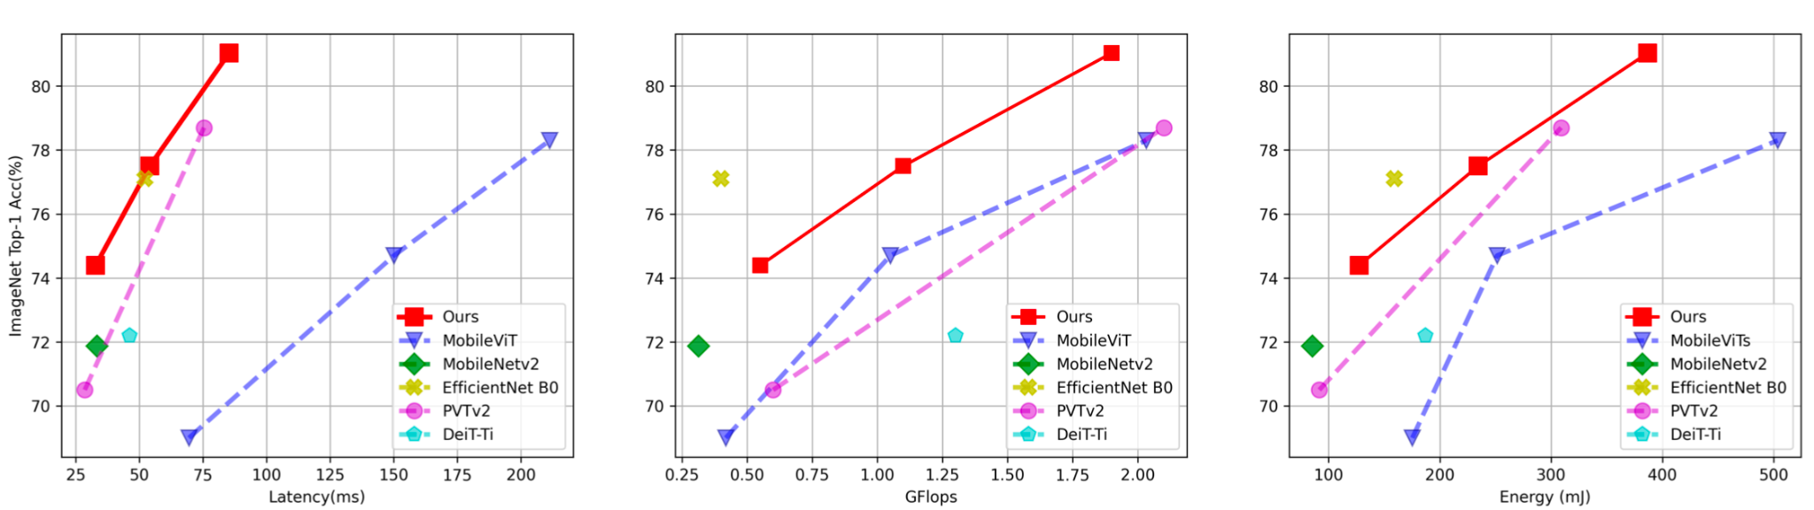
Results:
EdgeViTs vs. Effcient CNNs: Well Comparable 😃
EdgeViTs vs. ViTs variants: Significantly better 🥳
Table 1. Accuracy/Latency and Accuracy/Energy trade off on ImageNet-1K.
Testing device: Samsung Galaxy S21 (latency), Snapdragon 888 Hardware Development Kit (energy).
Notes:
We benchmark EdgeViTs on visual recognition tasks as well as two well known dense prediction tasks. On ImageNet-1K, we can see that our EdgeVits is well comparable to current sota efficient CNNs and dominating over representative generic ViTs and latest MobileViTs in terms of accuracy/latency tradeoffs.

Slide 11
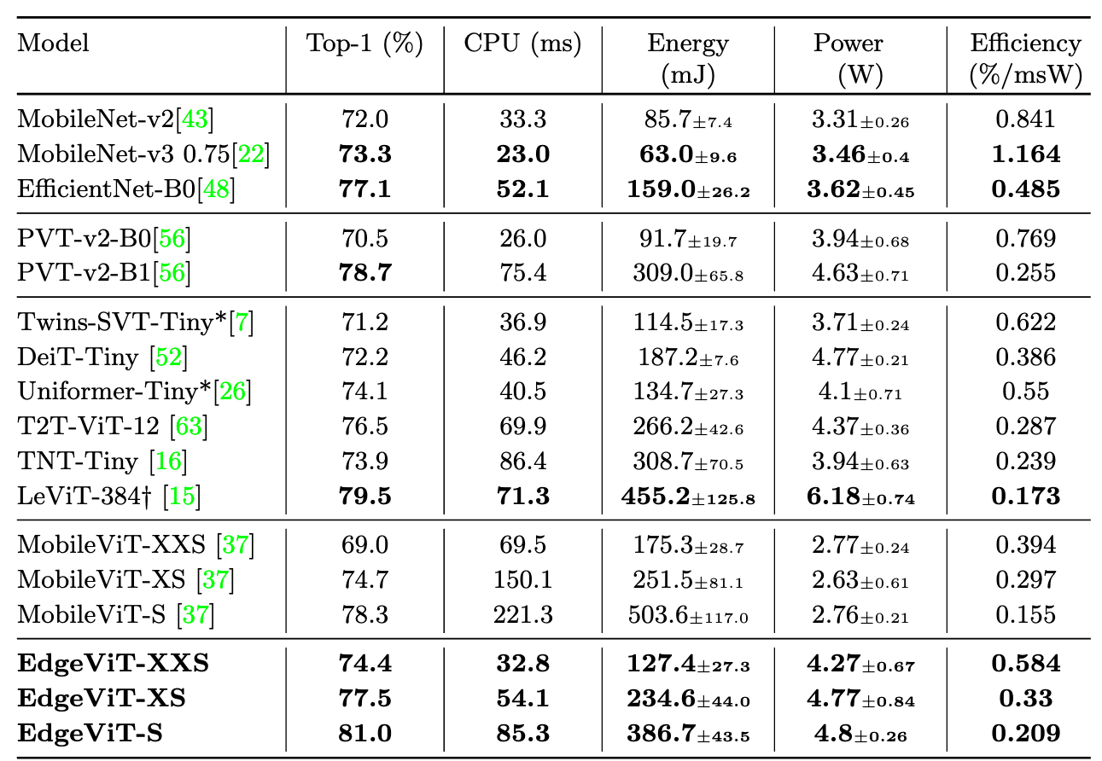
Image Classification on ImageNet-1K
Table 2. On-device energy evaluation on ImageNet-1K.
Notes:
In our paper, we also provide on device evaluation, including inference latency, and for the first time energy consumption, and power efficiency.

Slide 12
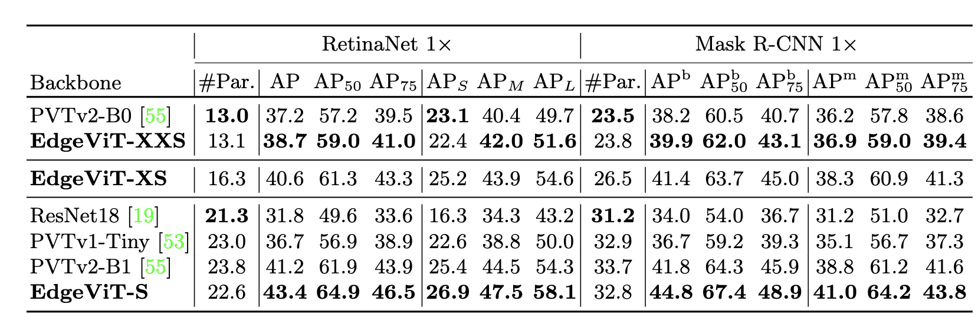
Object Detection and Segmentation on COCO-2017
Table 3. Comparison to other visual backbones using RetinaNet and Mask-RCNN on COCO val2017 object detection and instance segmentation.
Notes:
We demonstrate the performance of our model in two main-stream object detection and instance segmentation frameworks, we show the our EdgeViTs performs consistently better than other visual backbones.

Slide 13
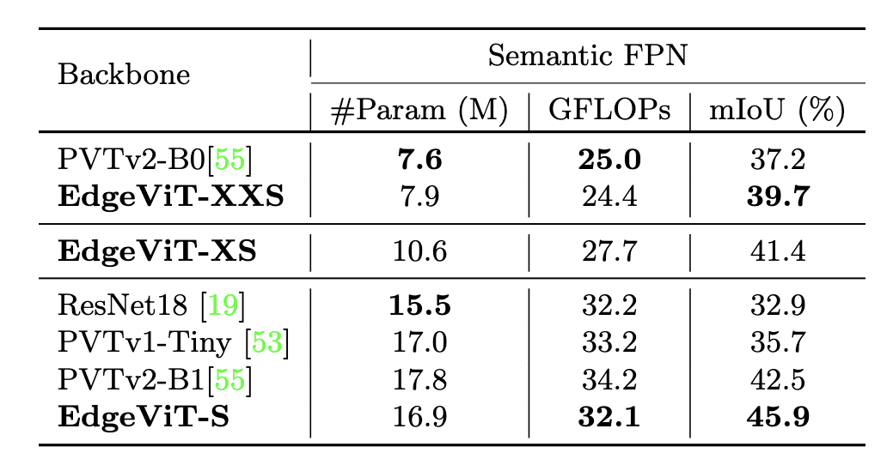
Scene parsing on ADE20K
Table 4. Semantic segmentation results on the validation set of ADE20K.
Notes:
As for the semantic segmentation task, we also observe similar advantages of our model.

Slide 14
Conclusions
On-device deployment perspective.
EdgeViTs with novel decomposition of self-attention
Extensive on-device experiments (speed, energy, power efficiency)
Notes:
In this work, we investigate the design of efficient Vision Transformers from the on-device deployment perspective.
We introduce EdgeVits with a novel decomposition of self-attention.
We conduct extensive on-device experiments using practically critical and previously underestimated metrics and reveal new insights and observations.

Slide 15

Please feel free to contact us if you have any question! ;)
junting.pa@gmail.com
Code is available at:
https://github.com/saic-fi/edgevit
Notes:
Please feel free to contact us if you have any question, more details can be found in our paper.
Code is available at the following link.
Thank you for watching!

